Slide 1
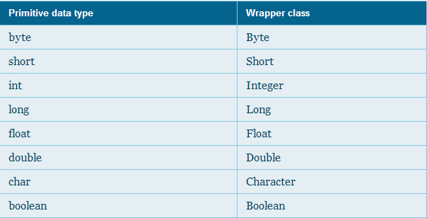
Wrapper Class
Wrapper classes are belongs to java.lang package

